Slide 1
Course Title: Geography of Ethiopia and the Horn
Course Code: CC121
Credit hour: 4
Video Lecture
Instructor: Demeke Hailu
E-mail – demeke81@gmail.com
oct, 2021
Addis Ababa, Ethiopia

Slide 2
Introduction to the Course
Until 2005, this course were given to all freshman students of the country.
It was interrupted in relation to curriculum revision.
After a recent curriculum revision (2011 EC).
One of the common course - Geography of Ethiopia and the Horn
The course is important to familiarize students with geographic concepts mainly in relation to Ethiopia and the Horn of Africa

Slide 3
Con’t…….
The course mainly consists of four major parts (Objectives)
Basic skills of geographic position
Physical background and resource endowment of Ethiopia
Demographic characteristics
Various economic activities

Slide 4
Course Content
In order to achieve the above stated objectives, the course has eight chapters.
Chapter One: Introduction
1.1. Geography: Definition, Scope and Themes
1.2. Location, Shape and Size of Ethiopia and the Horn
1.3. Basic Skills of Map Reading
Chapter Two: The Geology Of Ethiopia And The Horn
2.1. The Geologic Processes
2.2. The Geological Time scale
2.3. Resulting Landforms of Ethiopia and the Horn
2.4. Rock and Mineral Resources of Ethiopia

Slide 5
Con’t…….
Chapter Three: Topography of Ethiopia and
the Horn
3.1. The Physiographic Divisions of Ethiopia
3.2. The Impacts of Relief on Biophysical and
Socioeconomic Conditions
Chapter Four: Drainage Systems and Water Resource of
Ethiopia and the Horn
4.1. Major Drainage System of Ethiopia
4.2. Water Resources: Rivers, Lakes and Sub-Surface Water
4.3. Water Resources Potentials and Development in Ethiopia

Slide 6
Con’t…….
Chapter Five: The Climate of Ethiopia and the Horn
5.1. Elements and Controls of Weather and Climate
5.2. Spatiotemporal Patterns and Distribution of Temperature and Rainfall in Ethiopia
5.3. Climate Change/Global Warming: Causes, Consequences and Response Mechanisms
Chapter Six: Soils, Natural Vegetation and Wildlife Resources of Ethiopia and the Horn
6.1. Ethiopian Soils
6.2. Natural Vegetation of Ethiopia
6.3. Wild Life/Wild Animals in Ethiopia

Slide 7
Con’t…….
Chapter Seven: Population of Ethiopia and the Horn
7.2. Population Data: Uses and Sources
7.3. Population Dynamics: Fertility, Mortality and Migration
7.4. Age and Sex Structure of Ethiopian Population
7.5. Population Distribution in Ethiopia
7.6. Socio-cultural Aspects of Ethiopian Population
Chapter Eight: Economic Activities in Ethiopia
8.1. Primary Economic Activities
8.2. Secondary Economic Activities
8.3. Tertiary Economic Activities

Slide 8
Chapter One: Introduction
Chapter Objectives
At the end of this chapter, you should be able to:
Comprehend the meaning, scope and approaches of Geography.
Explain the themes of Geography.
Explicate the implications of location, shape and size of Ethiopia and the Horn on the physical environment, socioeconomic and political aspects.
Acquire basic skills of map reading.

Slide 9
1.1. Geography: Definition, Scope, Approach and Themes
1.1.1. Meaning of Geography
No universally accepted definition: Reasons
the dynamic nature of the discipline and
the changes in its scope and method of study.
? Do you remember the definition given by different scholars
Working definition.
Geography is the scientific study of the Earth that describes and analyses spatial and temporal variations of physical and human phenomena, and their interrelationships and dynamism over the surface of the Earth.

Slide 10
1.1.2. The Scope, Approaches and Themes of Geography
Scope
The scope of Geography is the surface of the Earth.
The interface of the four major subsystems;
land, water, living things and air commonly known as geo-spheres.
Atmosphere (troposphere): all the airs in the earths system
Lithosphere: the solid part of the earth’s surface. Eg. Rocks and related materials
Hydrosphere: Water bodies of the earth
Biosphere: includes all the planet living things

Slide 11
Con’t…….
Approach:
Two major approaches; Topical-regional
Topical (Systematic) Approach: applies a specific geographical element or phenomenon over a defined geographical unit.
Eg. The Geography of hunger, the Geography of Climate
Regional Approach: studies the main characteristics of each region of the world
Eg. The geography of Ethiopia, The Geography of Africa

Slide 12
Con’t…….
Themes:
Geography has five basic themes.
1. Location: is defined as a particular place or position.
Location can be of two types:
Absolute location and Relative location.
2. Place: physical and human aspects of a location
associated with:
toponym (the name of a place),
site (the description of the features of the place), and
Situation (the environmental conditions of the place).

Slide 13
Con’t…….
3. Human-Environment Interaction:
ceaseless interaction
No other species that has lived on our planet has a profound effect on the environment as humans.
The interaction involves three distinct aspects,
Dependency: dependent on nature for a living.
Adaptation: relates to how humans modify themselves, their lifestyles and their behavior to live in a new environment with new challenges.
Modification: allowed humans to “conquer” (overcome challenges) the world for their comfortable living.

Slide 14
Con’t…….
4. Movement: entails to the translocation of human beings, their goods, and their ideas from one end of the planet to another.
Movement has also three Aspects
physical movement of people
the transport of goods
the flow of ideas
5. Region: is a geographic area having distinctive characteristics that distinguish itself from adjacent unit(s) of space.
The region can be two forms;
It could be a formal region that is characterized by homogeneity in terms of a certain phenomenon.
It can also be a functional or nodal region characterized by functional interrelationships.

Slide 15
1.2. Location, Shape and Size of Ethiopia and the Horn
The Horn of Africa
a region of eastern Africa
It is the easternmost extension of African landmass
Home to the countries of Djibouti, Eritrea, Ethiopia, and Somalia,
Although the countries of the region share many common features, there is also great diversity among them, rendering each country unique in many respects.
In terms of size, Ethiopia is the largest of all the Horn of African countries, while Djibouti is the smallest.

Slide 16
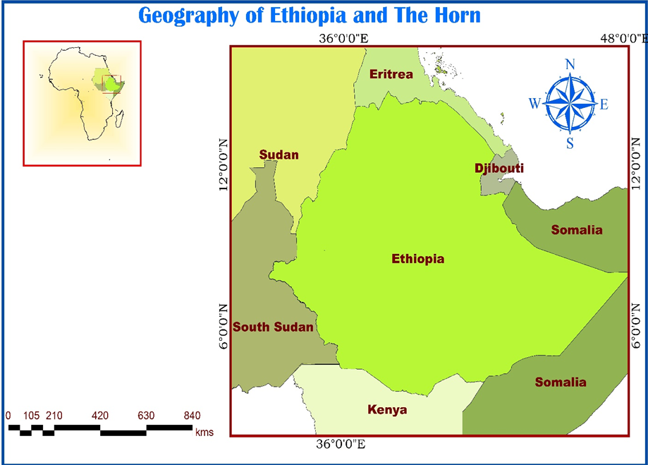
Con’t………

Slide 17
Con’t…….
1.2.1. Location of Ethiopia
Location is defined as the position of a place or an object on the earth’s surface.
It is the identification of a place, a country or a region in the world.
All places have two different types of location.
Absolute (Astronomical) and
Relative locations
1. Absolute location: also called Astronomical or mathematical location
refers to the exact position of a place or an object.
using the lines of latitudes and longitudes.

Slide 18
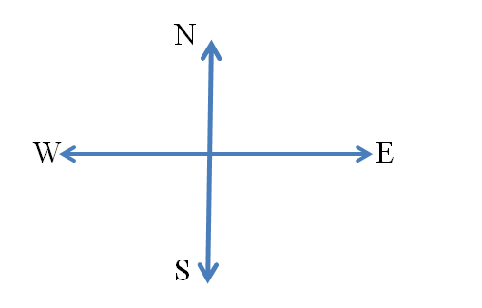
Con’t…….
Astronomically, Ethiopia is a landlocked country located between
3ºN to 15ºN latitudes and 33ºE to 48ºE longitudes
Moyale is the southernmost tip
Bademe is the northernmost tip
Akobo westernmost tip
Ogaden the easternmost tip

Slide 19
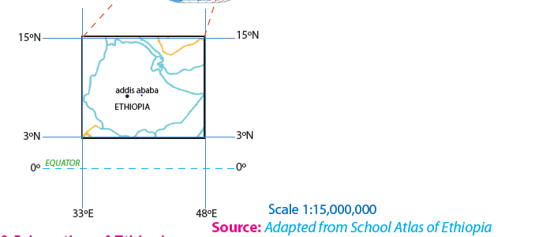
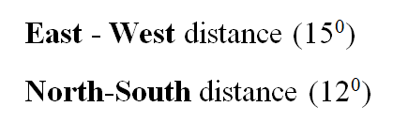
Con’t…….

Slide 20
Con’t…….
The latitudinal and longitudinal extensions are important in two ways.
First, as a result of its latitudinal extension the country experiences tropical climate and
Second, due to its longitudinal extension there is a difference of 1 hr’ between the most easterly and most westerly points of the country.
It is only for convenience that the 3 hours-time zone is used in all parts of the country.
2. Relative location: expresses the location of countries or places with reference to the location of other countries (vicinal), landmasses or water bodies.

Slide 21
Con’t…….
Table 1.1: The relative location of Ethiopia
Vicinal location | In relation to water bodies & land masses
Sudan to the west and northwest South Sudan to southwest Djibouti to the east Somalia to the east and southeast Eritrea to the north and northeast Kenya to the south | In the Horn of Africa Southwest of the Arabian Peninsula South of Europe Northwest of the Indian Ocean In the Nile Basin

Slide 22
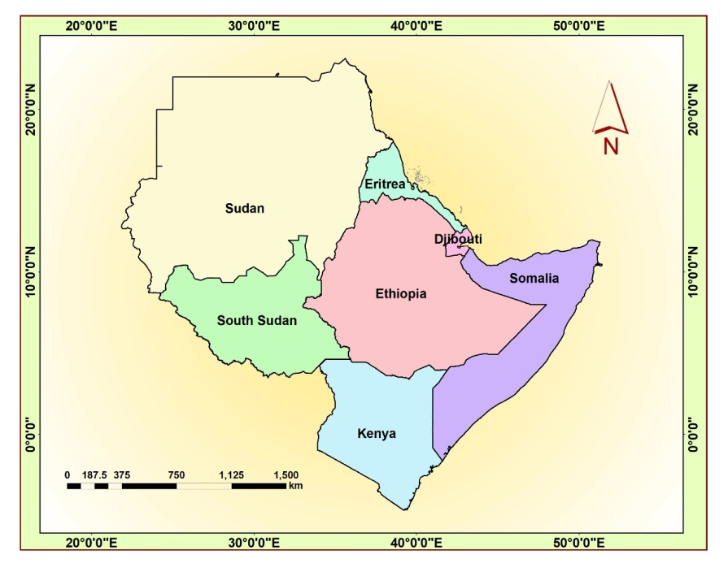
Con’t…….

Slide 23
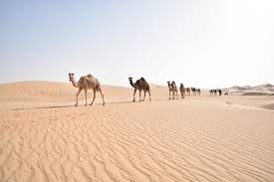

Con’t…….
The location of Ethiopia has three major implications: Climate, Socio-cultural and Political
Climate
Altitude

Slide 24
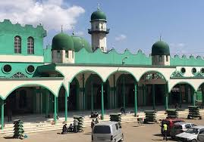

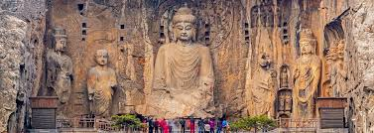
Con’t…….
2. Socio-cultural – recipient of the earliest religion
Orthodox Islam
Buddhism

Slide 25

Con’t…….
3. Political: center of politics
Is a strategic location to control Europe, Africa and Asia
Nearness to the Red Sea

Slide 26
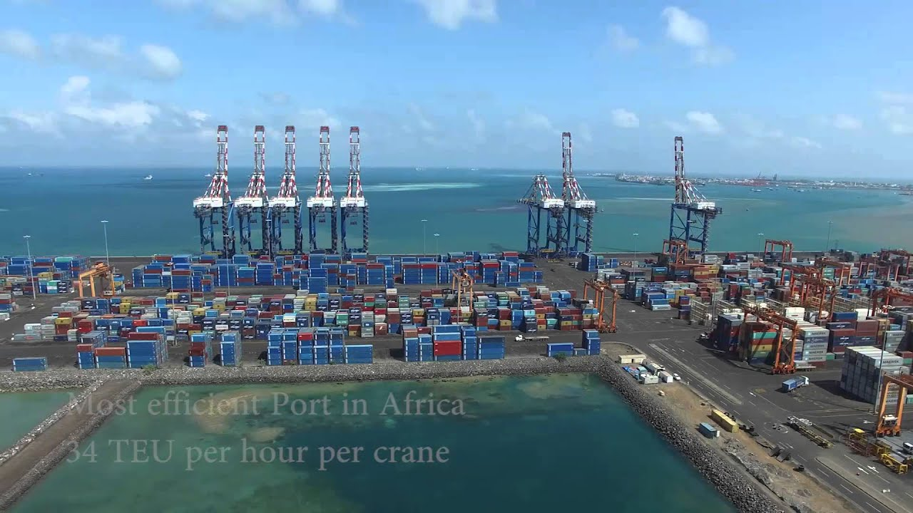
Con’t…….
4. Land-lockdeness:
The Sea Ports of Djibouti

Slide 27
Con’t…….
1.2.2. Areal Size of Ethiopia
1,106,000 KM²
8th largest in Africa
25th in the World.
1,639 kilometers East-West
1,577 kilometers North-South.
About 0.7% water bodies.

Slide 28
Con’t…….
Table 1.2: Advantages and disadvantages of Ethiopia’s large size
Advantages | Disadvantages
Possess diverse agro ecological zones | Demands greater capital to construct infrastructural facilities
Variety of natural resources | Requires large army to protect its territory
Own extensive arable land | Difficult for effective administration
Have larger population size | Difficult for socio-economic integration
Home for diverse cultures
Greater depth in defense external invasion

Slide 29
Con’t…….
1.2.3. The shape of Ethiopia and its Implication
Countries of the World have different kinds of shape that can be divided into five main categories:
compact,
fragmented,
elongated,
perforated, and
protruded.
These shapes have implications on defense, administration and economic integration within a country.

Slide 30
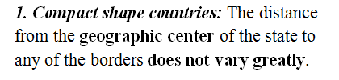
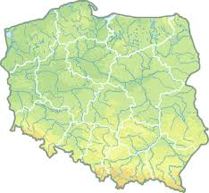
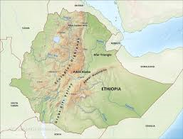
Con’t…….
Poland Ethiopia

Slide 31
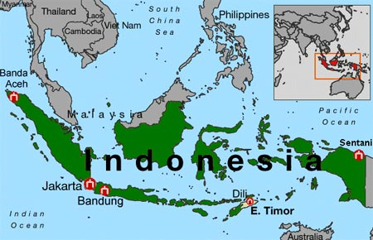
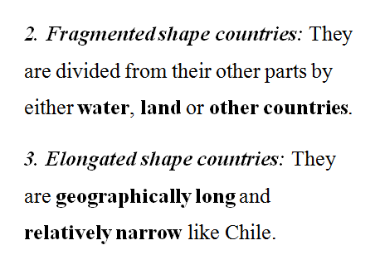
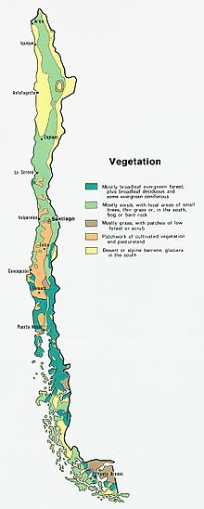
Con’t…….

Slide 32
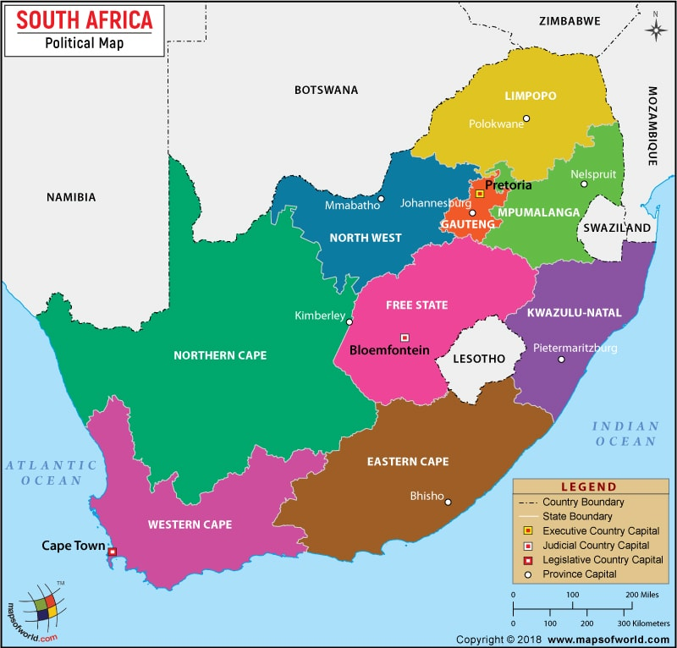
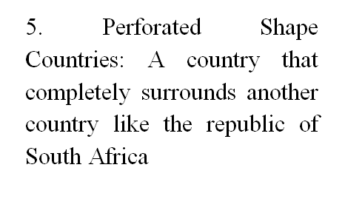
Con’t…….

Slide 33
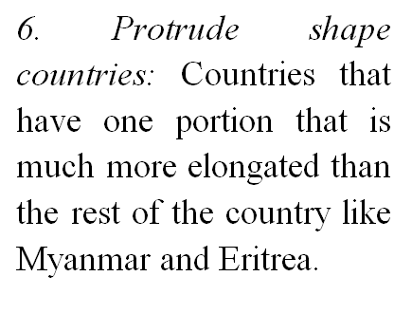
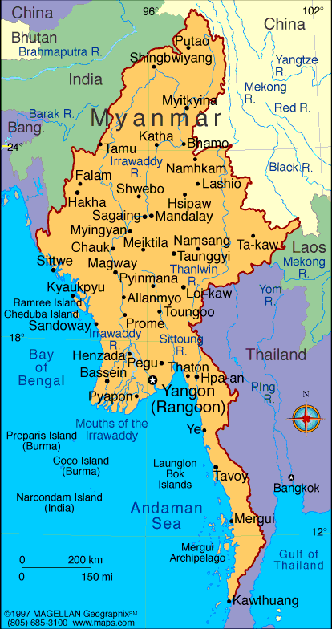
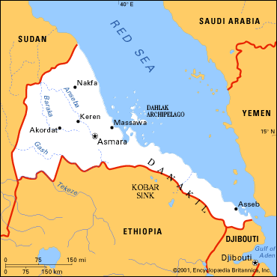
Con’t…….

Slide 34
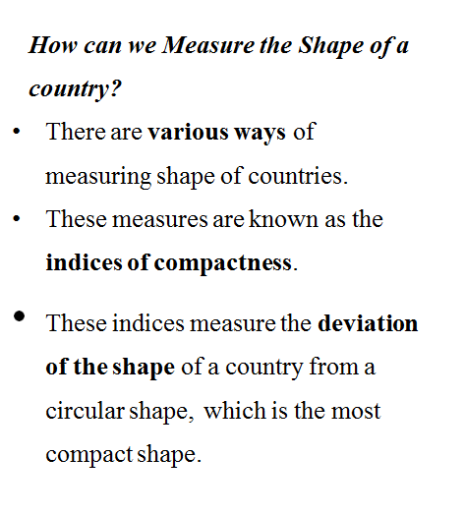

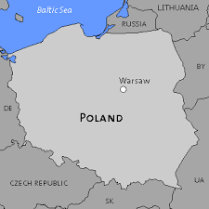
Con’t…….

Slide 35
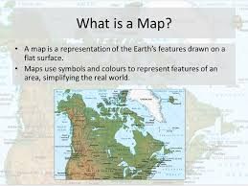
1.3. Basic Skills of Map Reading
What is a Map?
A map is a two-dimensional scaled representation of part or whole of the Earth surface on a flat body such as piece of paper, black board, wood or cloth.

Slide 36
1.3. Basic Skills of Map Reading
Map reading encompasses a systematic identification of natural features and manmade features.
Natural features include mountains, plateaus, hills, valleys, river, ocean, rocks, plain etc.
manmade features include roads, railway, buildings, dam etc.
Since these features cannot easily be observed and interpreted in real landscapes, maps are essential to Geographers.

Slide 37
Con’t……..
Importance of maps
Provide the basis for making geographical details of regions
Maps are powerful tools for making spatial analysis of geographical facts of areas represented.
Maps are useful for giving location of geographical features
Map makes storage of the geographical data of areas represented.
Maps are potentially used to asses’ reliable measurements of the geographical features.
The measurements can be of area size, distance etc.

Slide 38
Con’t……..
Types of Map
There are many types of maps according to their purpose and functions.
For the purpose of this course, topographical and statistical maps are considered.
1. Topographical maps: Topographic maps depict one or more natural and cultural features of an area.
They could be small, medium or large scale depending on the size of the area represented.
Contents of topographical maps depend on purpose of a map, scale of a map, date of compilation, and nature of the land represented.
2. Special purpose/statistical maps: These are maps, which show distribution of different aspects such as temperature, rainfall, settlement, vegetation etc.

Slide 39
Con’t……..
Marginal Information on Maps (Elements of Maps)
Marginal information is shown on a map to enable the reading and interpretation of the geographical information of an area represented. This includes:
Title: It is the heading of the given map which tells what the map is all about.
Ex: Map of Ethiopia

Slide 40
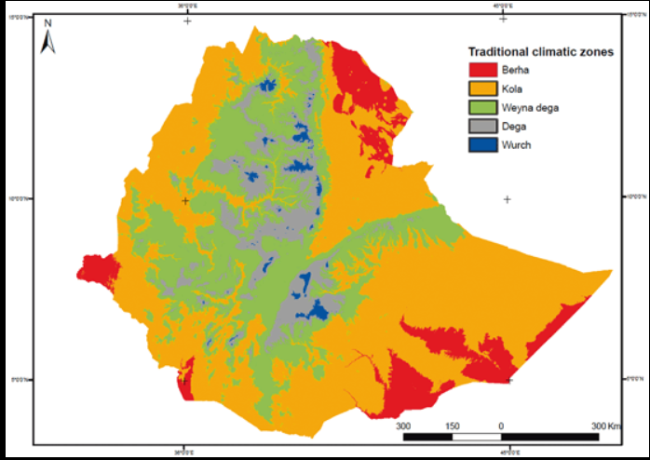
Con’t……..
Key (legend): It is the list of all convectional symbols and signs shown on the map with their interpretation.
Margin: Is the frame of the map. It is important for showing the end of the mapped area.

Slide 41
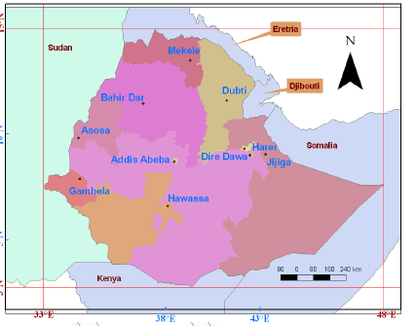
Con’t……..
Scale: It is the ratio between the distance on the map and the actual ground distance.
North arrow: It is indicated with the north direction on a map; used to know the other important directions of the mapped area like east, south, and west.

Slide 42
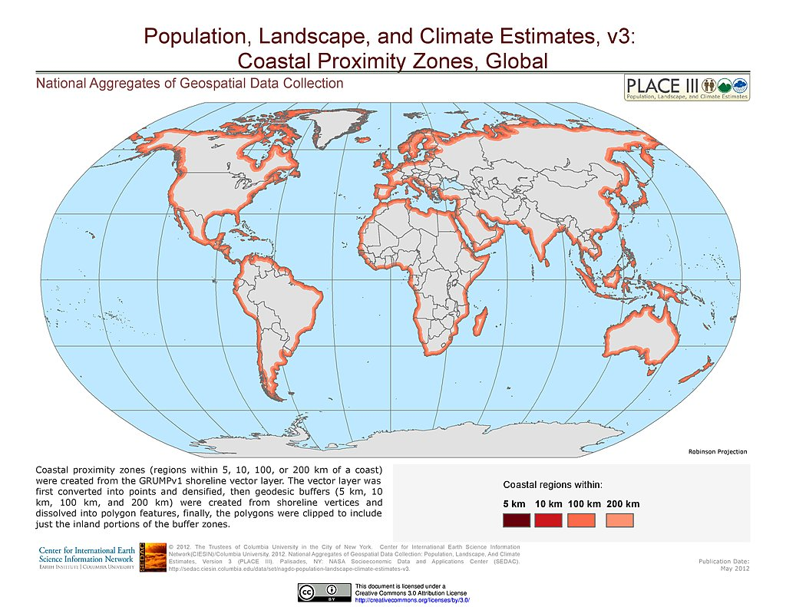
Con’t……..
Date of compilation: It is a date of map publication. This enables map users to realize whether the map is updated or outdated.

Slide 43
Con’t……..
Basic Principles of Map Reading
In developing map reading abilities and skills, certain basic principles must be applied by the map-reader to translate map symbols into landscape images.
Map Readers must have ideas about the symbol and also the real World (landscapes).
 
Secondly, knowledge of directions is an important principle in reading maps.
N
W E
S

Slide 44
Summary of the Lesson
Main points of the lesson
1.1. Geography: definition, scope, approach and theme
1.2. Geographic position of Ethiopia and the Horn
Location of Ethiopia and the horn
Absolute and Relative location
implications of Ethiopia’s location
Areal size of Ethiopia
Advantages and Disadvantages of Ethiopia’s areal size
Shape of Ethiopia
the five categories of shape
measurement of country’s shape
1.3. Basic Skills of Map Reading
Definition, importance, type, elements and principles

